Slide 1
Group 1
PROJECT PROPOSAL
106-1 12/7 Software Engineering Design

Slide 2
Homework

Slide 3
Requirements Statement
A powerful application can present multiple documents at the same time.
These documents include DrawingDocument, TextDocument, and so on.
The application is responsible for managing documents and creating them as required

Slide 4
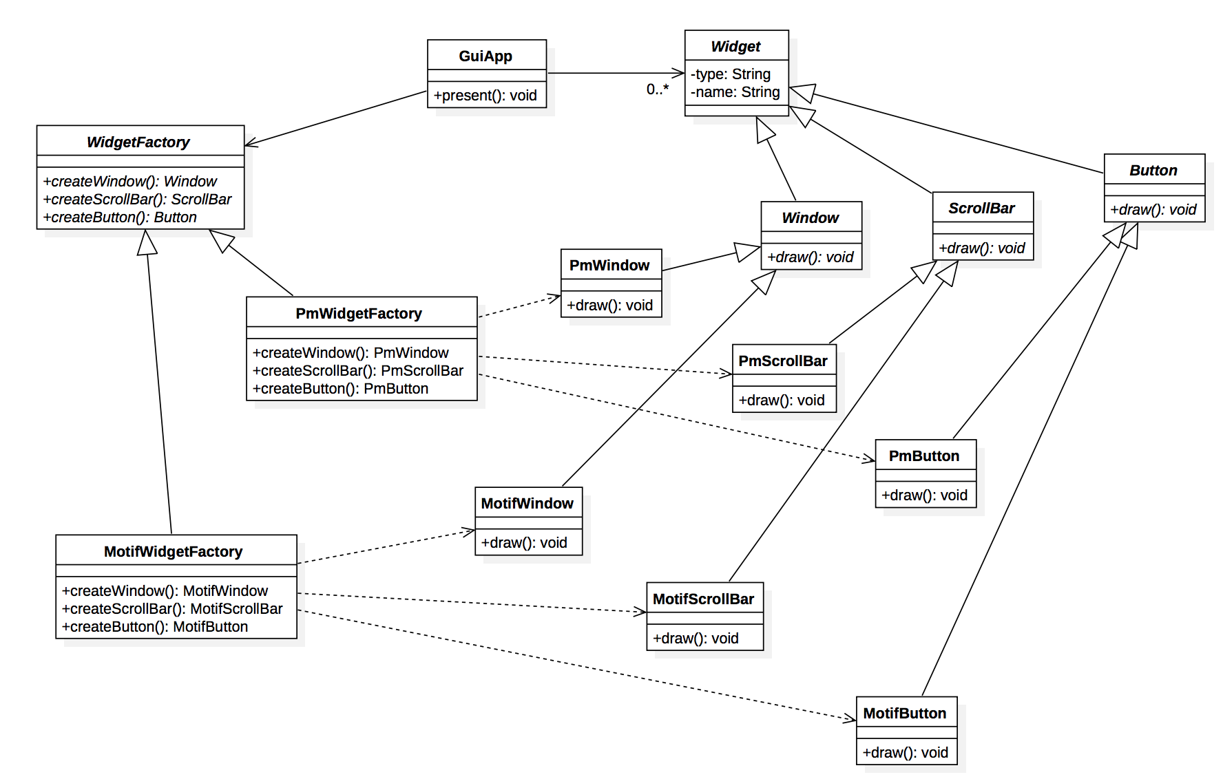
HW1: Power Document Viewer

Slide 5
Requirements Statement
A GUI Application consists of various types of widgets such as window, scroll bar, and button.
Each widget in the GUI application has two or more implementations according to different look-and-feel standards, such as Motif and Presentation Manager.
The GUI application can switch its look-and-feel style from one to another while the widgets are being created

Slide 6
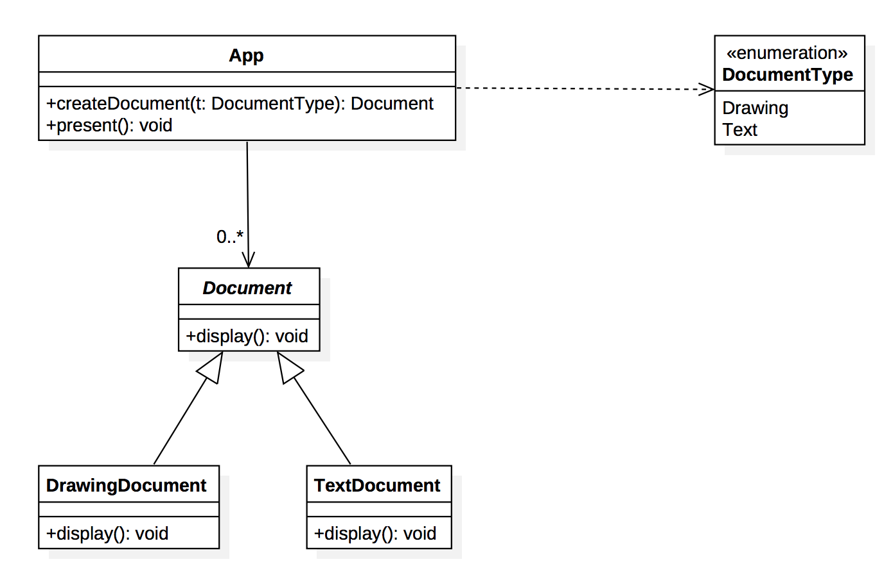
HW2: GUI Application

Slide 7
Open Source Work-Through
Graph
Event
Set
Multiset

Slide 8
Graph
Graph
Event
Set
Multiset
Iterator Pattern & Graph

Slide 9
Iterator Pattern
Intent:
Provide a way to access the elements of an aggregate object sequentially without exposing its underlying representation.
Iterator Pattern Class Diagram

Slide 10
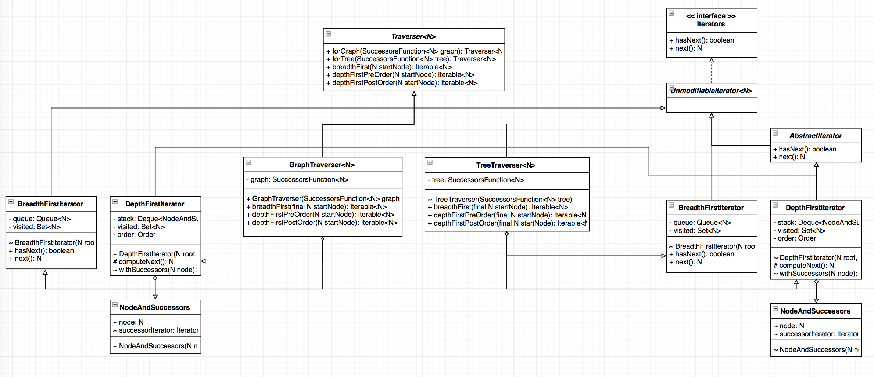
Graph Traverse Iterator
Notes:
Traverser: container
Iterators: Iterator
common.graph does not (at this time) include explicit support for the following graph variants, although they can be modeled using the existing types:
trees, forests
graphs with elements of the same kind (nodes or edges) that have different types (for example: bipartite/k-partite graphs, multimodal graphs)
hypergraphs
common.graph does not allow graphs with both directed and undirected edges.

Slide 11
Event
Graph
Event
Set
Multiset
EventBus, Optional, and Supplier

Slide 12
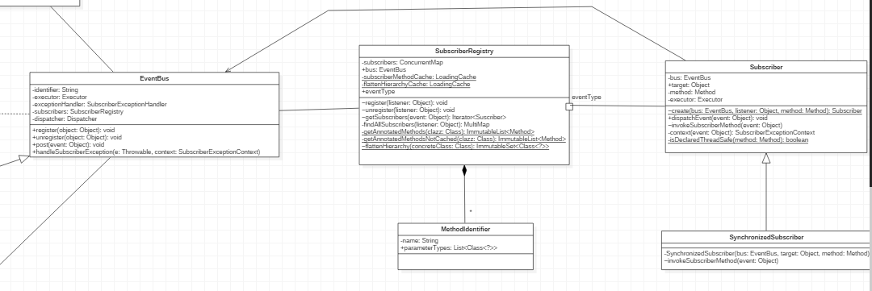
EventBus

Slide 13
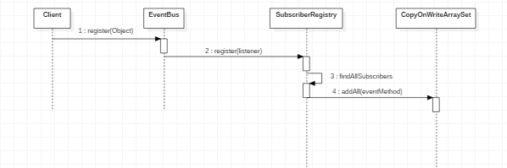
EventBus
Register

Slide 14
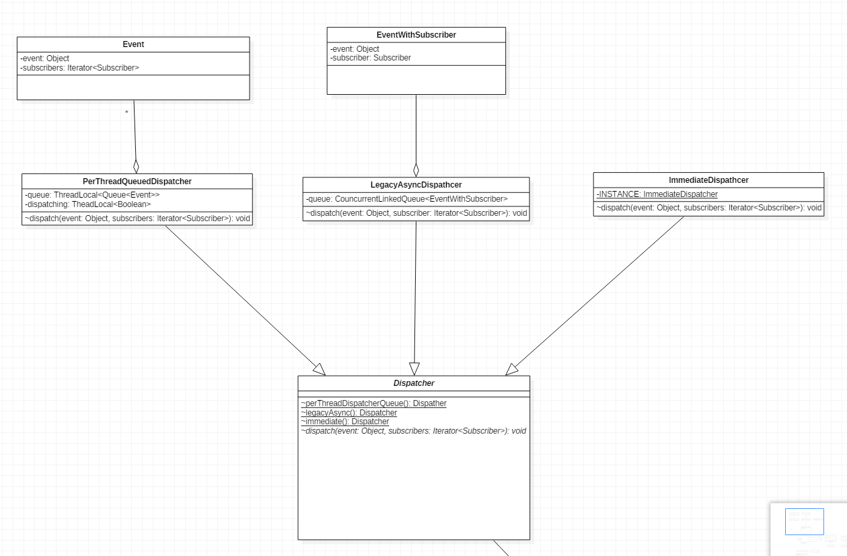
EventBus

Slide 15
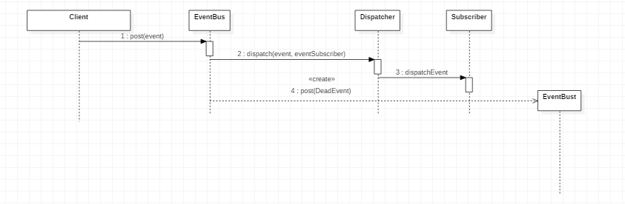
EventBus

Slide 16
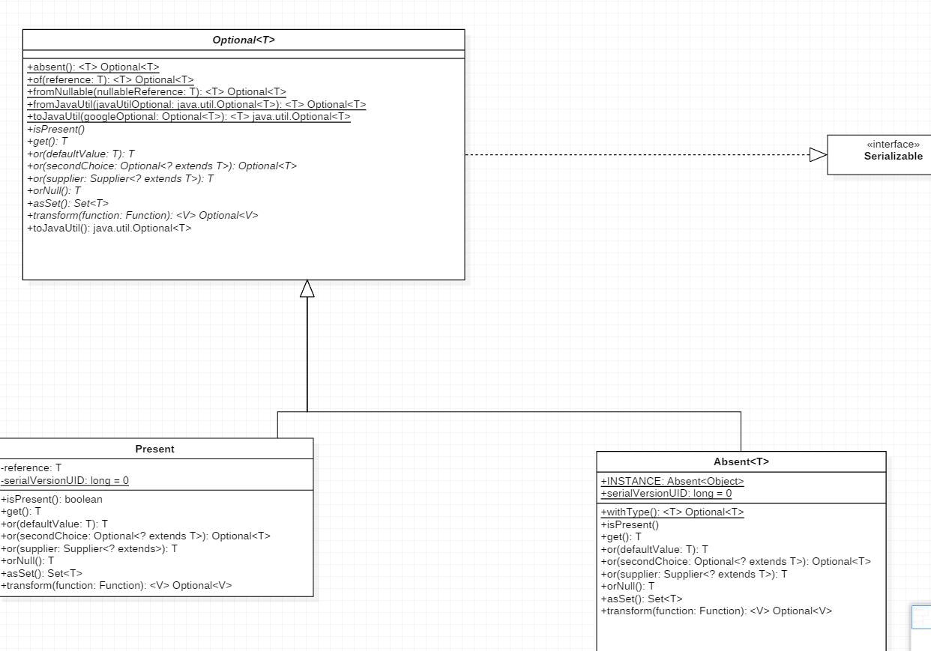
Optional

Slide 17
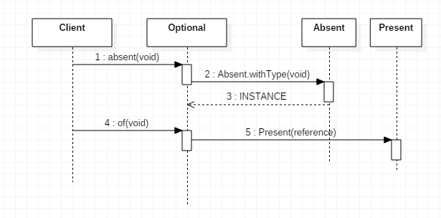
Optional

Slide 18
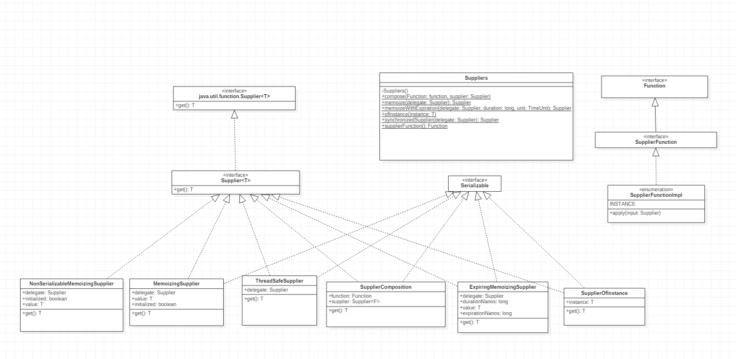
Supplier

Slide 19
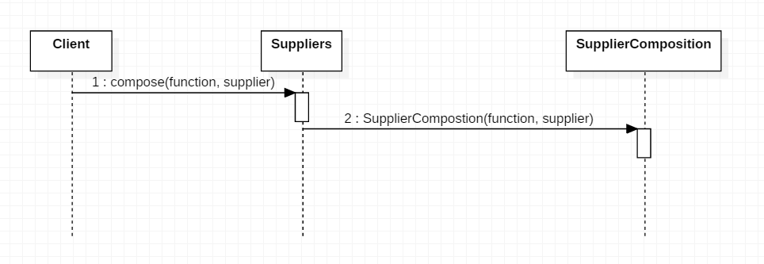
Supplier

Slide 20
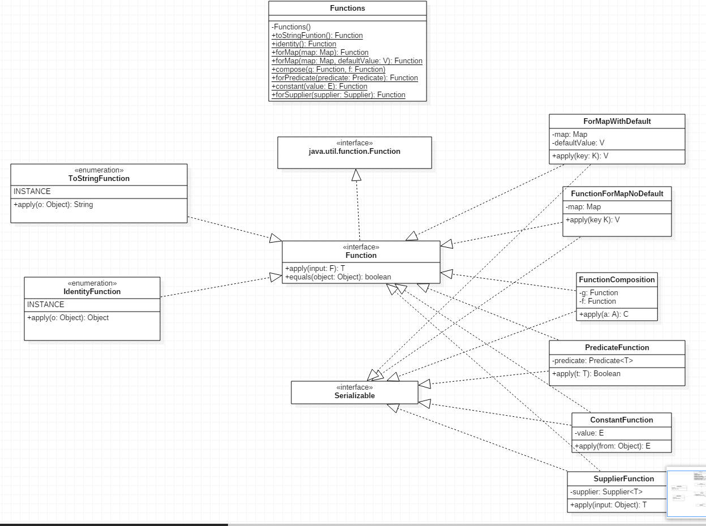
Function

Slide 21
Set
Graph
Event
Set
Multiset
Immutable Set

Slide 22
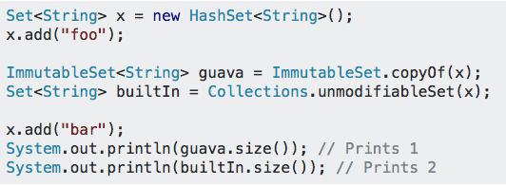
Immutable
Safe for use by untrusted libraries.
Thread-safe: can be used by many threads with no risk of race conditions.

Slide 23
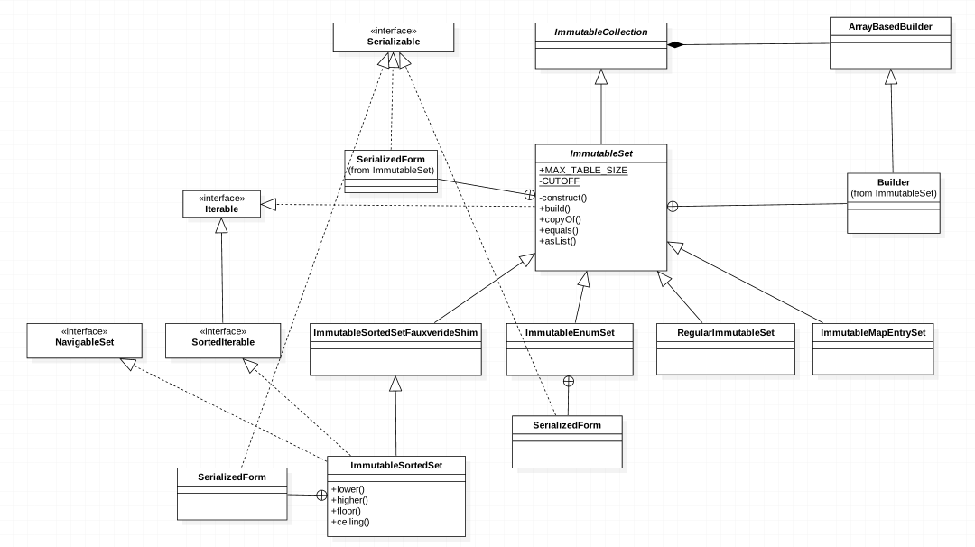

Slide 24
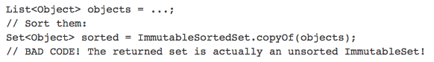
ImmutableSortedSetFauxverideShim
“Overrides” the ImmutableSet static methods
Lack ImmutableSortedSet equivalents with deprecated

Slide 25
Multiset
Graph
Event
Set
Multiset
AbstractMultiset, ImmutableMultiset
ForwardingMultiset, and SortedMultiset

Slide 26
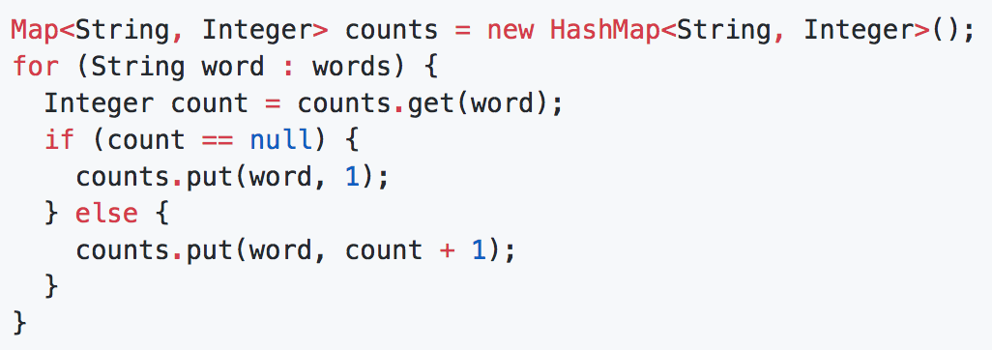
Multiset
Why Multiset:
Features:
like an ArrayList<E> without an ordering constraint
like a Map<E, Integer>, with elements and counts

Slide 27
Preview: Collection Framework in Java
http://www.kriblog.com/

Slide 28
Preview: Set hierarchy in java
/** Copyright (c), AnkitMittal
JavaMadeSoEasy.com */

Slide 29
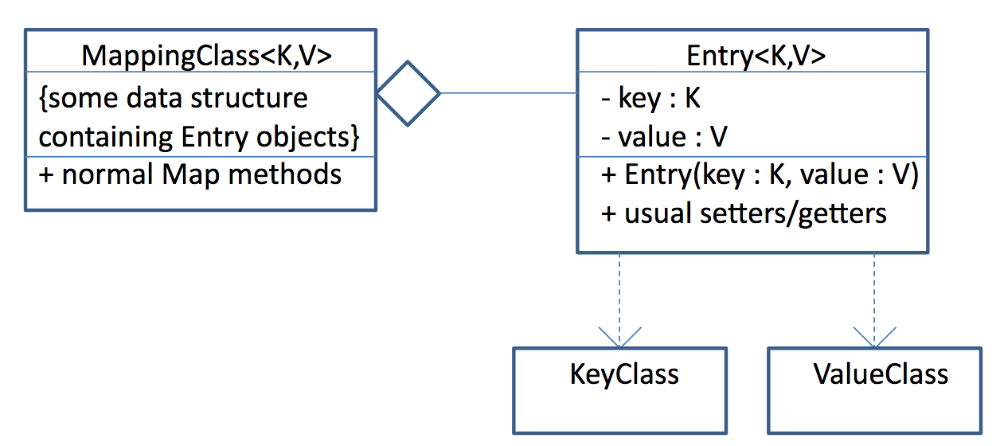
Preview: Map framework in java
https://read01.com/Po8Eok.html

Slide 30
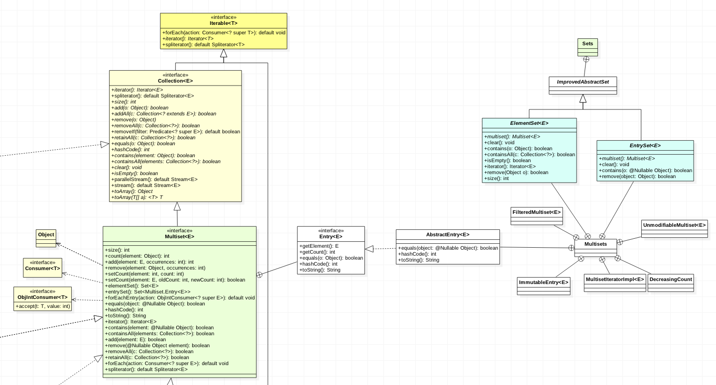
Multiset

Slide 31
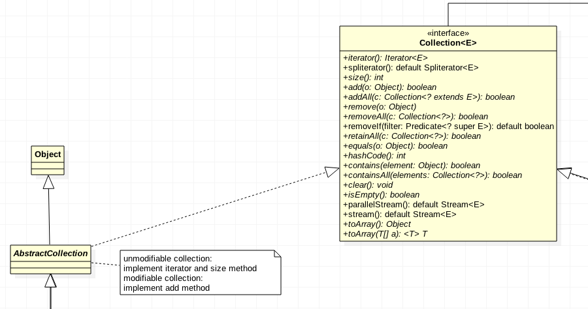
Multiset-AbstractCollection

Slide 32
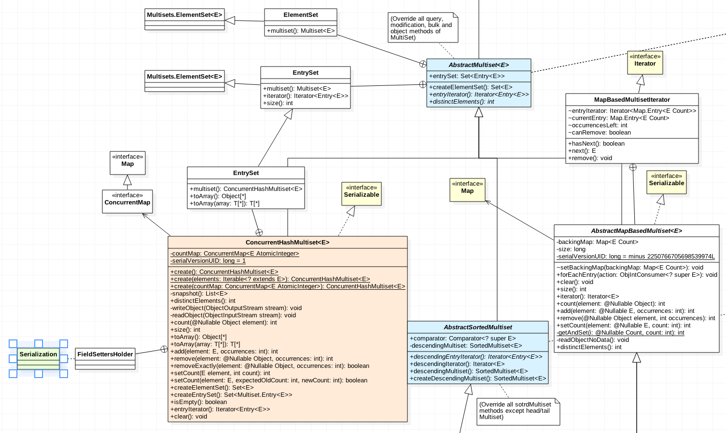
AbstractMultiset

Slide 33
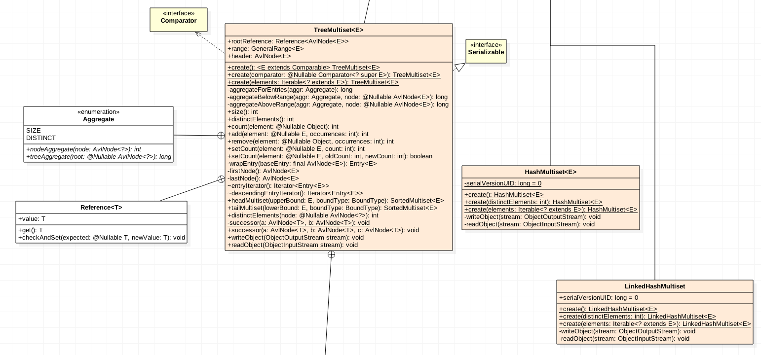
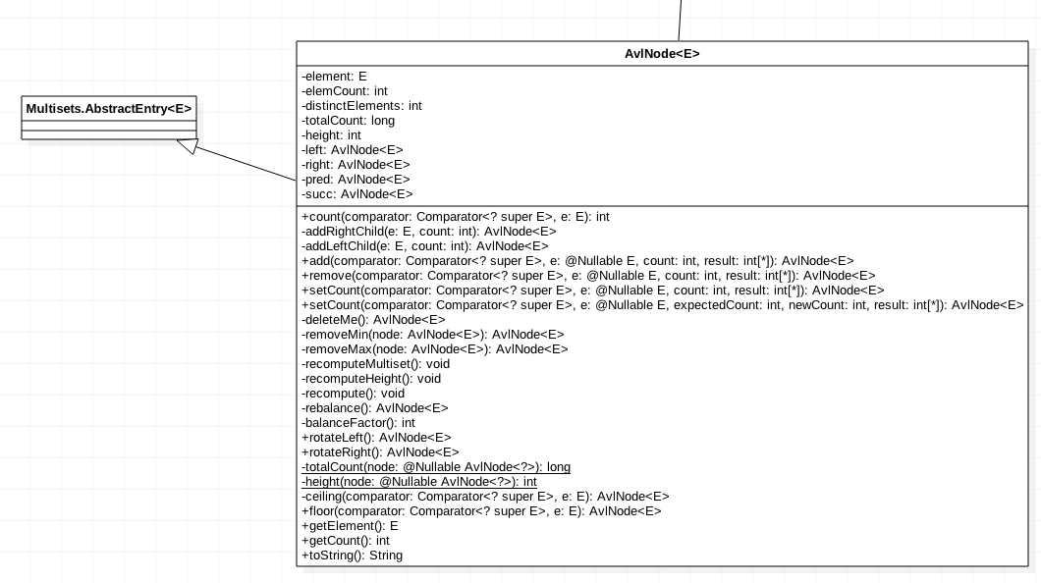
AbstractMultiset

Slide 34
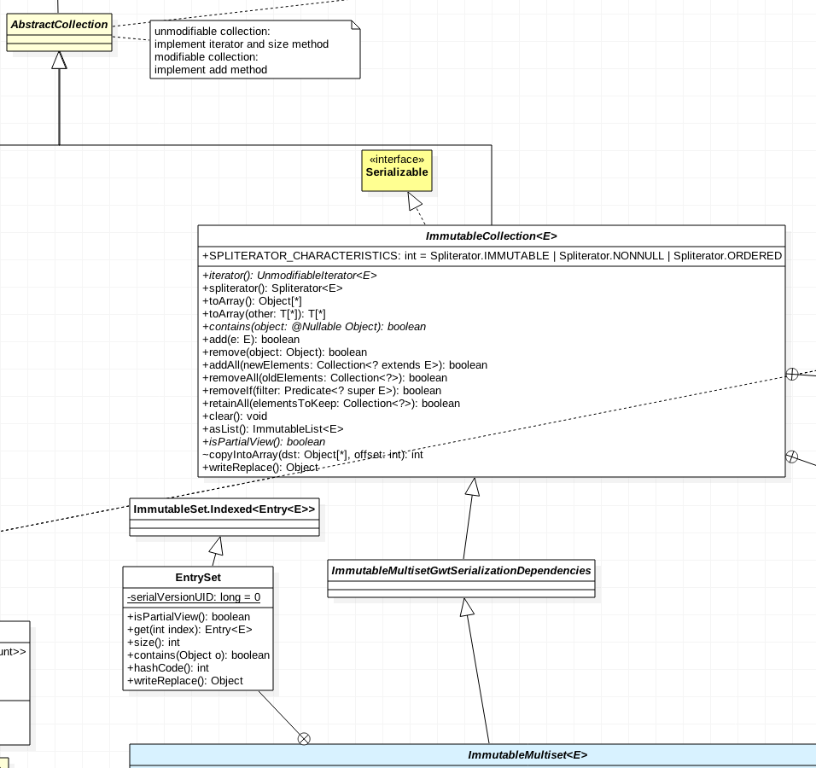
Immutable Collection

Slide 35
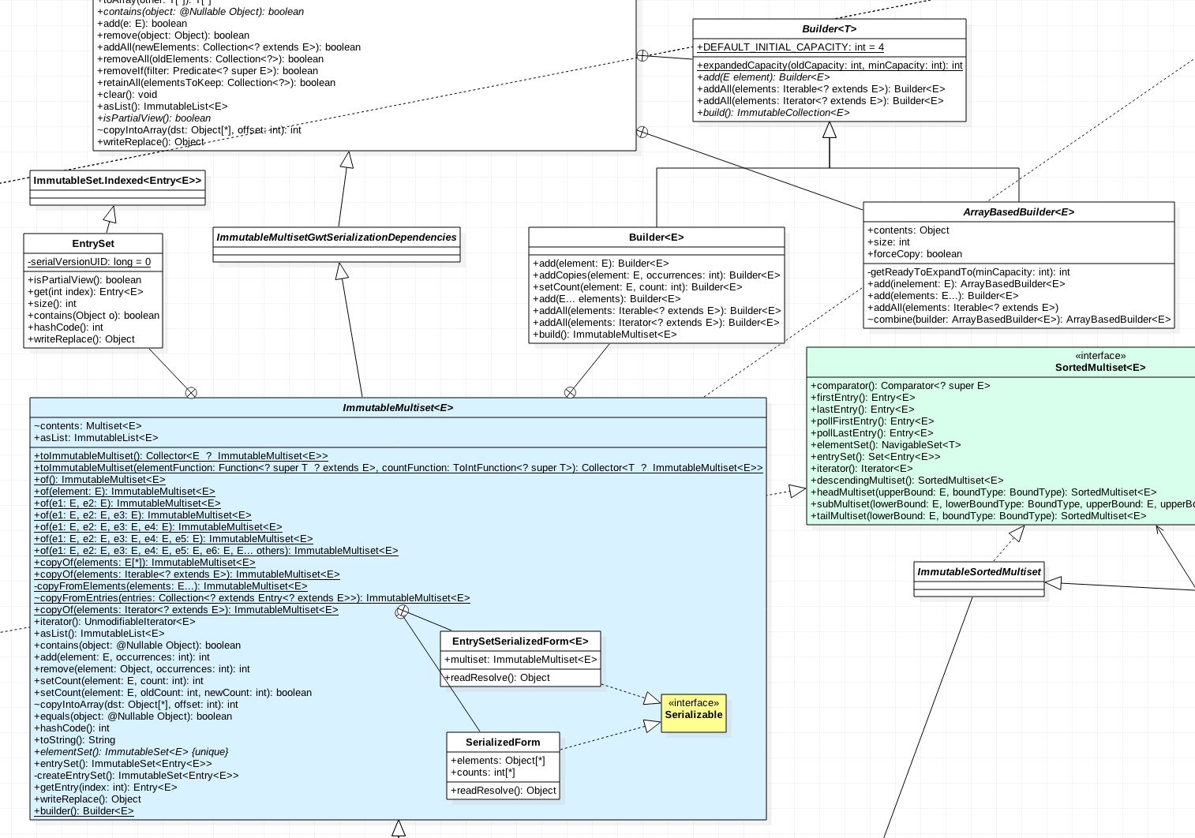
Immutable Multiset

Slide 36
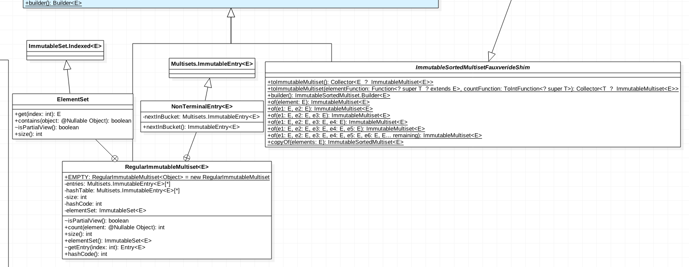
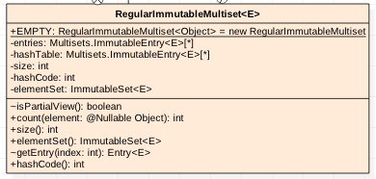
RegularImmutableMultiset

Slide 37
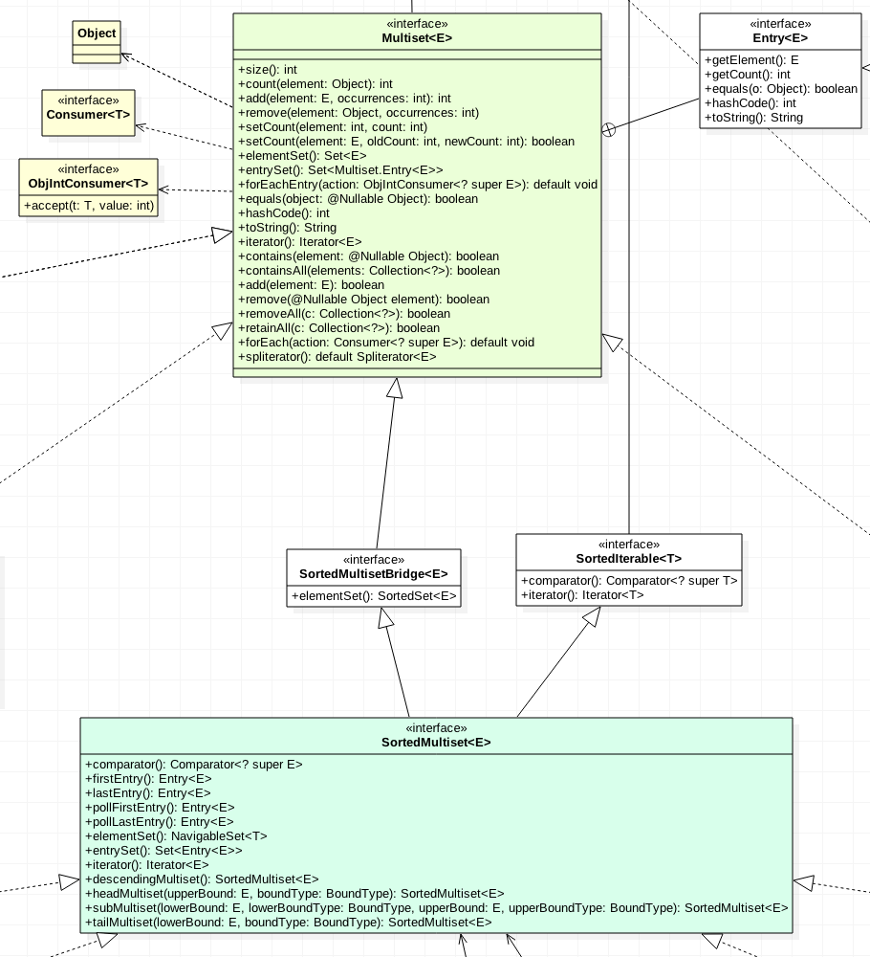
SortedMultiset

Slide 38
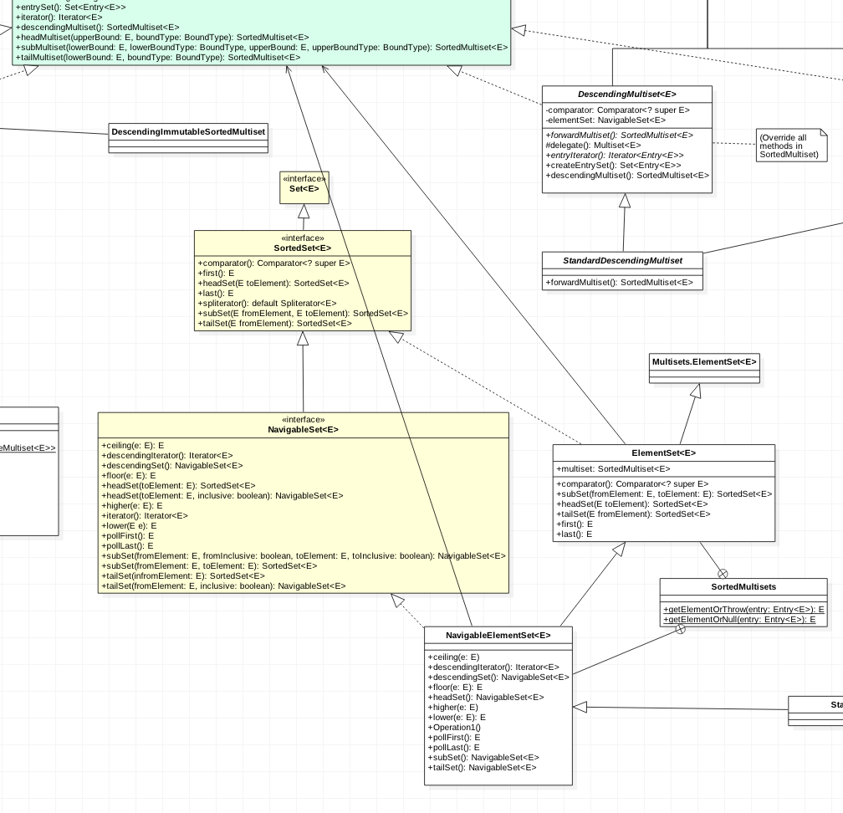
SortedMultiset

Slide 39
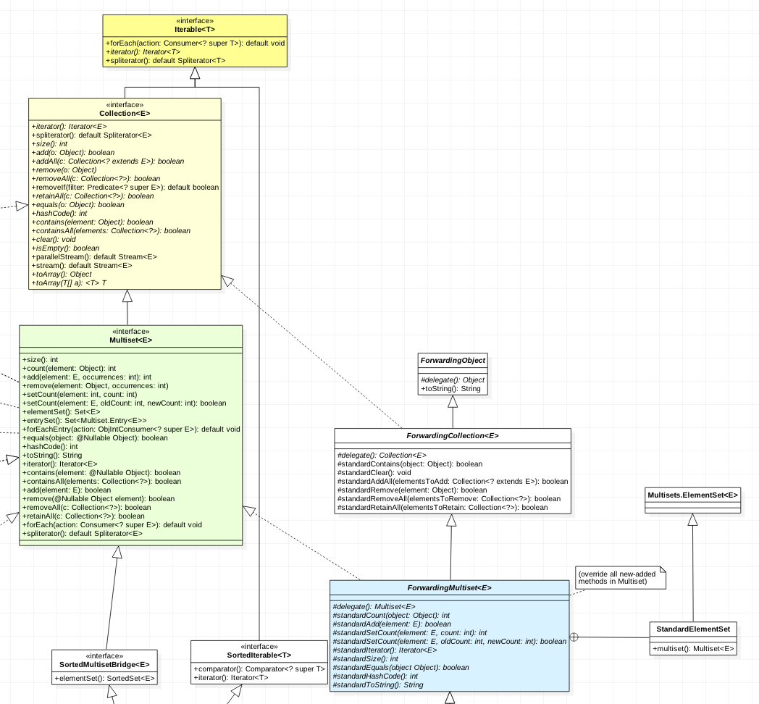
ForwardingMultiset
In object-oriented programming, forwarding means that using a member of an object (either a property or a method) results in actually using the corresponding member of a different object: the use is forwarded to another object.

Slide 40
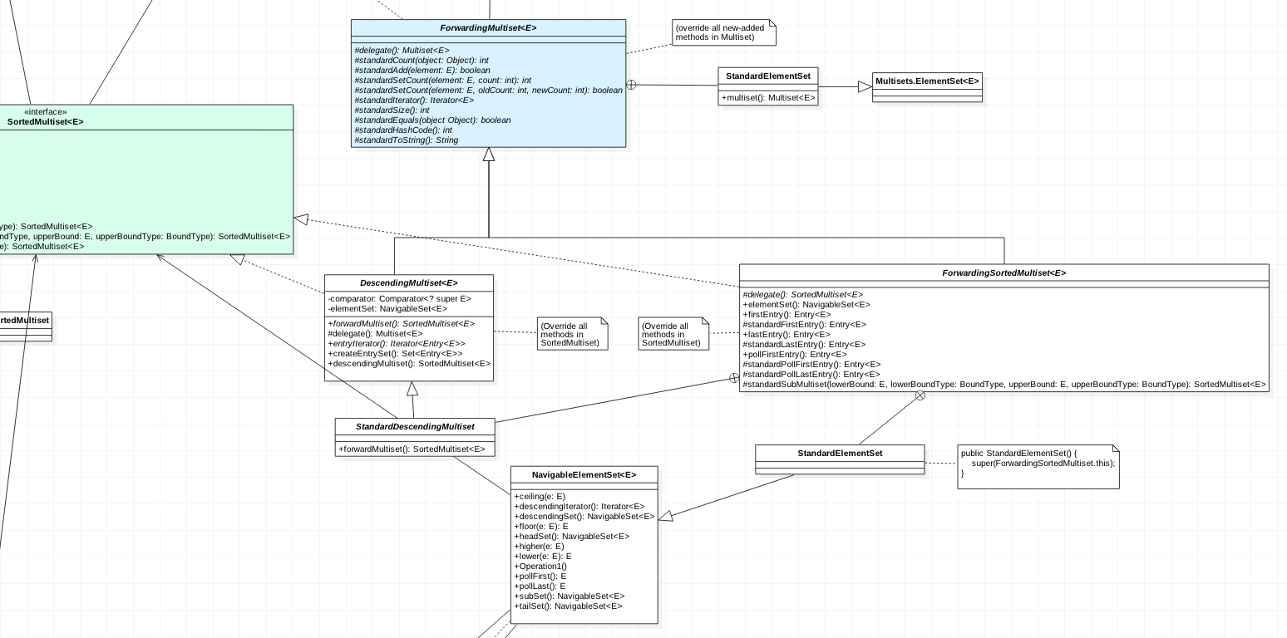
ForwardingMultiset

Slide 41
Thanks!
Any questions?

